Slide 1
MCA105-Operating System

Slide 2
Agenda
Directory Structure
File allocation

Slide 3
Directory Structure
A collection of nodes containing information about all files
Directory
Files
F 1
F 2
F 3
F 4
F n
Both the directory structure and the files reside on disk
Backups of these two structures are kept on tapes

Slide 4
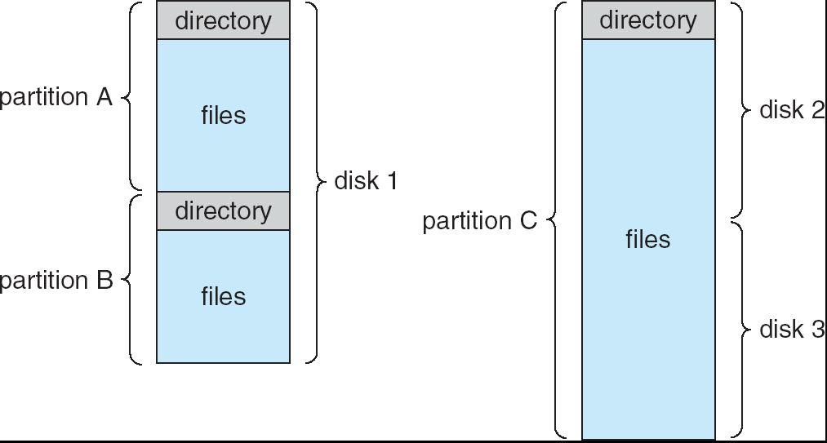
A Typical File-system Organization

Slide 5
Operations Performed on Directory
Search for a file
Create a file
Delete a file
List a directory
Rename a file
Traverse the file system

Slide 6
Directory Organization(Logically)
Efficiency – locating a file quickly
Naming – convenient to users
Two users can have same name for different files
The same file can have several different names
Grouping – logical grouping of files by properties, (e.g., all Java programs, all games, …)

Slide 7
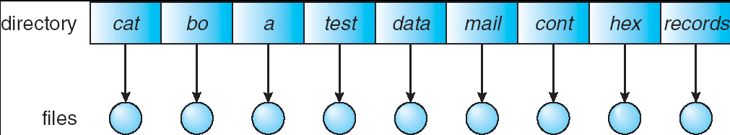
Single-Level Directory
A single directory for all users
Naming problem
Grouping problem

Slide 8
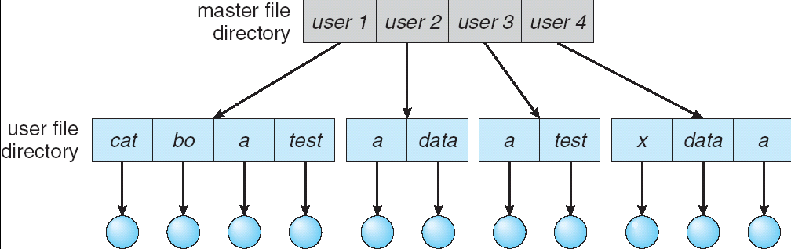
Two-Level Directory
Separate directory for each user
Can have the same file name for different user
Efficient searching
No grouping capability

Slide 9
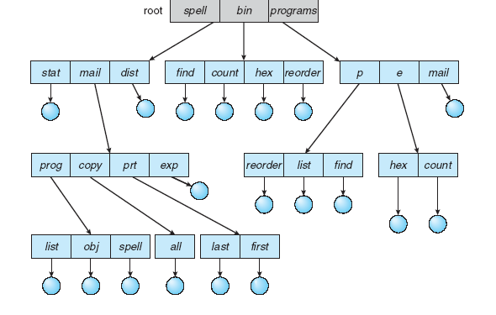
Tree-Structured Directories

Slide 10
Tree-Structured Directories (Cont)
Efficient searching
Grouping Capability
Current directory (working directory)

Slide 11
Tree-Structured Directories
Absolute or relative path name
Creating a new file is done in current directory
Delete a file
rm <file-name>
Creating a new subdirectory is done in current directory
mkdir <dir-name>
Example: if in current directory /mail
mkdir count
mail
prog
copy
prt
exp
count
Deleting “mail” ⇒ deleting the entire subtree rooted by “mail”

Slide 12
Tree-Structured Directories-Advantages
Tree-structure allows each user to create additional subdirectories
allows us to use the current directory as a working directory without the need to specify the whole path name
The deletion of a directory must be recursive to delete all subdirectories and files under the directory

Slide 13
Cons…
None of the above three directory structures enable sharing of files or subdirectories
Adding additional links can result in a general graph or an acyclic graph

Slide 14
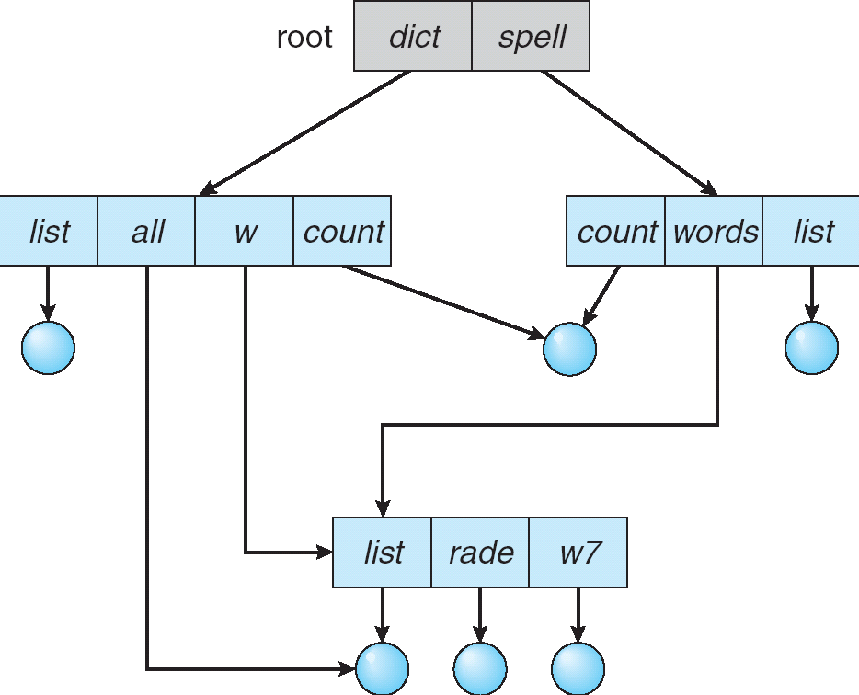
Acyclic-Graph Directories
Have shared subdirectories and files

Slide 15
Acyclic-Graph Directories (Cont.)
Two different names (aliasing)
Dangling pointer
Solutions:
Back pointers, so we can delete all pointers
Entry-hold-count solution
New directory entry type
Link – another name (pointer) to an existing file
Resolve the link – follow pointer to locate the file

Slide 16
Pros & Cons
Acyclic-graph approach enables sharing
The common implementation is to define a "link" as a pointer to another file or subdirectory
The link can be resolved by using the path name. File now can have more than one file names (distinct)

Slide 17
Pros & Cons
The deletion is complicated
since this might leave "dangling links", as the file itself could be deleted, yet the link pointing to it still exists
Or we have to track all the references to a file; unless there is no reference, the file can not be deleted
Notes:
Reference count if reference count is zero delete the file

Slide 18
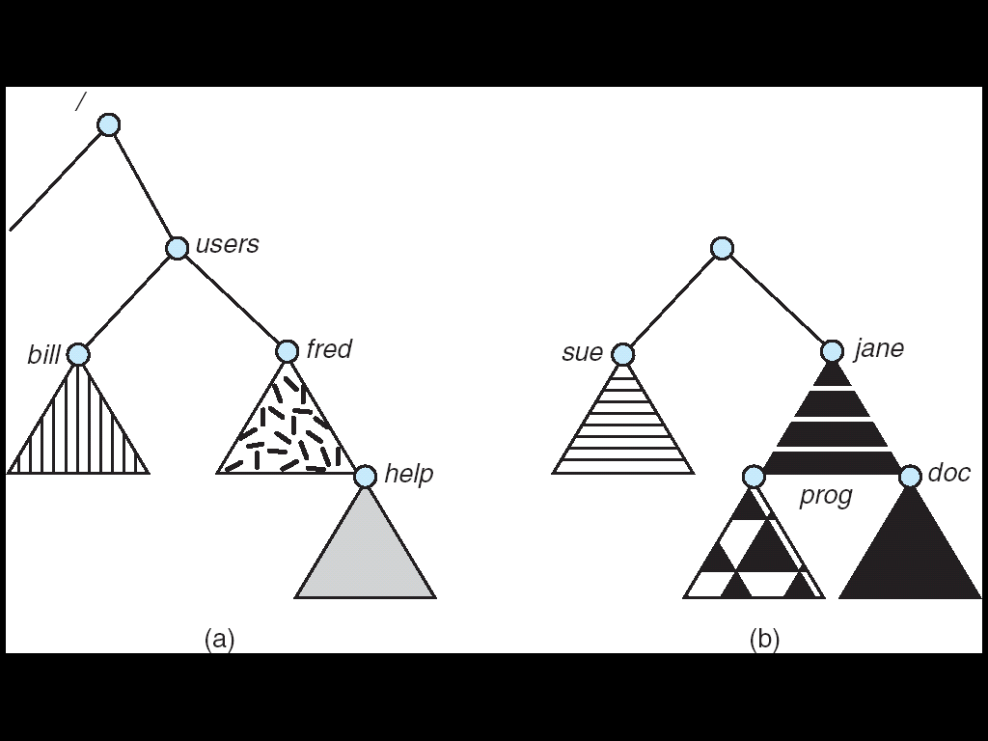
File System Mounting
A file system must be mounted before it can be accessed
A un-mounted file system is mounted at a mount point

Slide 19
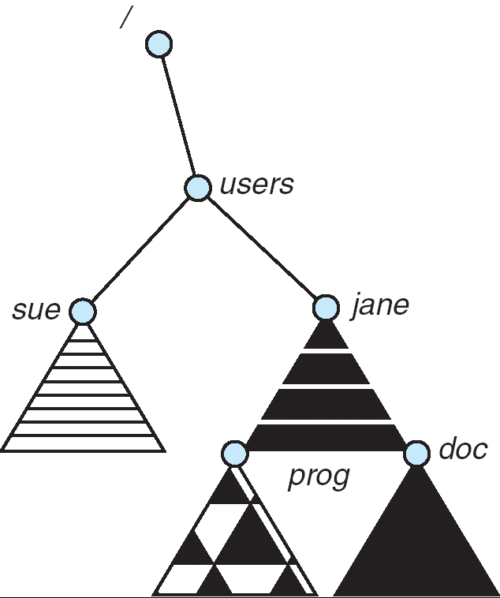
Mount Point

Slide 20
File Sharing
Sharing of files on multi-user systems is desirable
Sharing may be done through a protection scheme
On distributed systems, files may be shared across a network
Network File System (NFS) is a common distributed file-sharing method

Slide 21
File Sharing – Multiple Users
User IDs identify users, allowing permissions and protections to be per-user
Group IDs allow users to be in groups, permitting group access rights

Slide 22
File Sharing – Remote File Systems
Uses networking to allow file system access between systems
Manually via programs like FTP
Automatically, seamlessly using distributed file systems
Client-server model allows clients to mount remote file systems from servers
Server can serve multiple clients
Standard operating system file calls are translated into remote calls

Slide 23
File Sharing – Failure Modes
Remote file systems add new failure modes, due to network failure, server failure
Recovery from failure can involve state information about status of each remote request

Slide 24
Protection
File owner/creator should be able to control:
what can be done
by whom
Types of access
Read
Write
Execute
Append
Delete
List

Slide 25
Access Lists and Groups
Mode of access: read, write, execute
Three classes of users
RWX
a) owner access 7 ⇒ 1 1 1 RWX
b) group access 6 ⇒ 1 1 0
RWX
c) public access 4 ⇒ 100

Slide 26
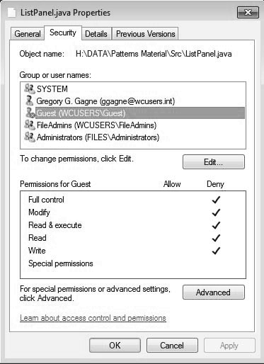
Windows 7 Access-Control List Management

Slide 27
File-System Structure
File structure
Logical storage unit
Collection of related information
File system resides on secondary storage (disks)
Provided user interface to storage, mapping logical to physical
Provides efficient and convenient access to disk by allowing data to be stored, located retrieved easily
Disk provides in-place rewrite and random access
I/O transfers performed in blocks of sectors (usually 512 bytes)
File control block – storage structure consisting of information about a file
Device driver controls the physical device
File system organized into layers

Slide 28
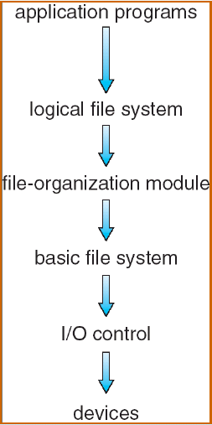
Layered file system
includes file-system structure and manages directory structure. A file control block (FCB) contains information about the file
logical block to physical block translation and also manage the free blocks on the disk
issue generic commands to device driver to read/write physical blocks on the disk, e.g., drive 3, cylinder 60, track12, sector 10
Transfer block between memory and the disk. This deals with interrupt, device drivers

Slide 29
File System Layers
Device drivers manage I/O devices at the I/O control layer
Given commands like “read drive1, cylinder 72, track 2, sector 10, into memory location 1060” outputs low-level hardware specific commands to hardware controller
Basic file system given command like “retrieve block 123” translates to device driver
Also manages memory buffers and caches (allocation, freeing, replacement)
Buffers hold data in transit
Caches hold frequently used data
File organization module understands files, logical address, and physical blocks
Translates logical block # to physical block #
Manages free space, disk allocation

Slide 30
File System Layers (Cont.)
Logical file system manages metadata information
Translates file name into file number, location by maintaining file control blocks
Directory management
Protection
Layering useful for reducing complexity and redundancy, but adds overhead and can decrease
Logical layers can be implemented by any coding method according to OS designer

Slide 31
File-System Implementation
We have system calls at the API level, but how do we implement their functions?
On-disk and in-memory structures
On-Disk structure
Boot control block contains info needed by system to boot OS from that volume
Needed if volume contains OS, usually first block of volume
Volume /Partition control block (superblock(UFS), master file table(NTFS) contains volume details
Total # of blocks, # of free blocks, block size, free block pointers or array
Directory structure organizes the files
Names and inode numbers(UFS), master file table(NTFS)
Per file FCB

Slide 32
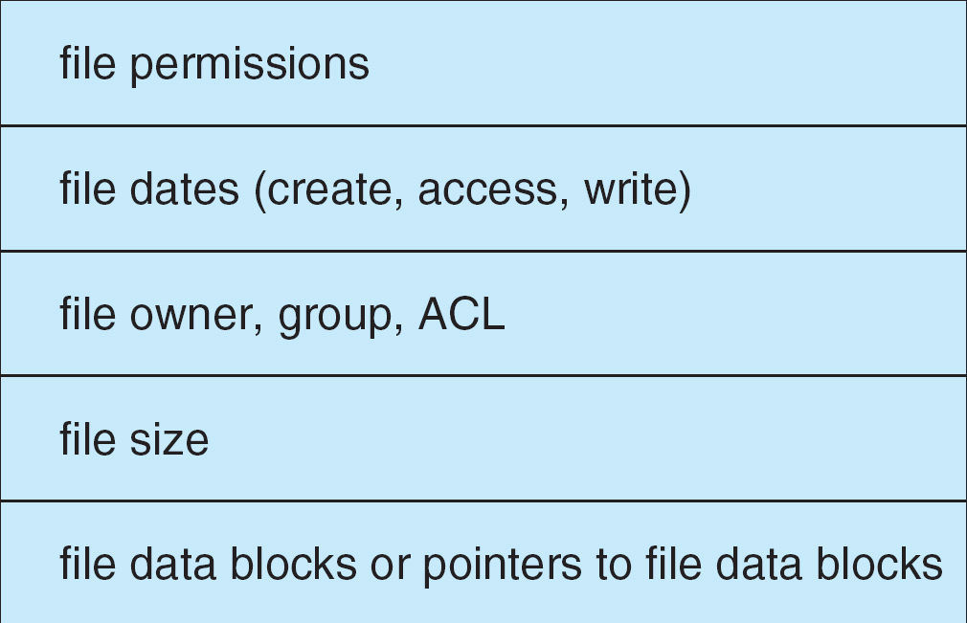
A Typical File Control Block

Slide 33
In-memory file system structure
In-memory partition table
In-memory directory structure
System wide open-file table
Per-process open-file table

Slide 34
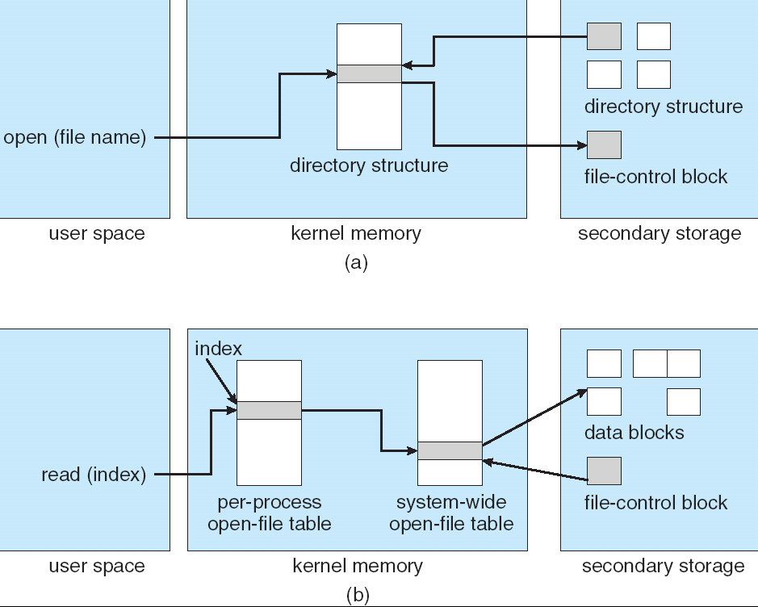
In-Memory File System Structures

Slide 35
Partitions and Mounting
Partition can be a volume containing a file system (“cooked”) or raw – just a sequence of blocks with no file system
Boot block can point to boot volume or boot loader set of blocks that contain enough code to know how to load the kernel from the file system
Or a boot management program for multi-os booting
Root partition contains the OS, other partitions can hold other Oses, other file systems, or be raw
Mounted at boot time
Other partitions can mount automatically or manually
At mount time, file system consistency checked
Is all metadata correct?
If not, fix it, try again
If yes, add to mount table, allow access

Slide 36
Directory Implementation
Linear list of file names with pointer to the data blocks.
simple to program
time-consuming to execute
Hash Table – linear list with hash data structure.
decreases directory search time
collisions – situations where two file names hash to the same location
fixed size

Slide 37
Allocation Methods
An allocation method refers to how disk blocks are allocated for files:
Contiguous allocation
Linked allocation
Indexed allocation

Slide 38
THANK YOU

